Slide 1

MINI PROJECT DEMAND FORECASTING IN E-COMMERCE

Slide 2
BATCH D5 PRESENTED BY: 211422104565-YUVASHREE R 211422104520-THIRUMALAVIKA S PROJECT CO-ORDINATOR: DR TAMILVIZHI T DOMAIN: MACHINE LEARNING

Slide 3
ABSTRACT
This project focuses on developing a demand forecasting system to enhance inventory control and production scheduling by utilizing sales history and external factors influencing demand.
Three forecasting models were employed: Dynamic Regression, which integrates external variables, seasonality, and market conditions to adapt to changing demand drivers; Multivariate Regression, which incorporates multiple predictors such as economic indicators and prior sales data to capture demand forces; and Time Series Analysis, which examines historical cycles and seasonality using tools like ARIMA for precise forecasting. Proper data cleaning was conducted to maintain accuracy, and Mean Absolute Percentage Error (MAPE) was applied to assess model performance. The system is crucial for the cardboard manufacturing company, as it optimizes the supply chain, reduces waste, manages inventory effectively, and ensures customer satisfaction by accurately capturing product demand patterns

Slide 4
OBJECTIVE
The objective of this project is to develop an effective demand forecasting system that enhances control and production scheduling by utilizing sales history and external factors. entory control and production scheduling by utilizing sales history and external factors. By maintaining data accuracy and evaluating model performance through Mean Absolute Percentage Error (MAPE), the project seeks to optimize the supply chain, minimize waste, improve inventory management, and enhance customer satisfaction for the cardboard manufacturing company

Slide 5
Problem Statement
Problem:
The cardboard manufacturing industry faces significant challenges in forecasting future demand due to unstable market conditions, climatic changes, and other factors. Poor demand forecasting leads to issues such as overstocking, stockouts, high storage costs, and missed sales, impacting logistics, performance, and profitability. Currently, the company lacks an effective system to predict demand, resulting in difficulties in maintaining optimal stock levels, meeting customer needs, and avoiding extra expenses. To address these challenges, a demand forecasting system using big data analysis, historical sales, and economic variables is essential for improving inventory control and production scheduling.

Slide 6
EXISTING SYSTEM
Presently, e-commerce firms usually carry out their demand forecasting in a basic way through the use of he sales history and simple mathematical formulae. Regular techniques like moving averages or a seasonal pattern are often employed in sales projection. These methods often do not consider things like advertisements, changes in the occasion, or competitor’s action thereby making predictions less accurate. Further, most of the current systems do not support real time forecasting of market conditions and hence the business cannot easily change its strategies to meet changing market conditions. As useful as such conventional tools may be in establishing some of the simplest trends, they are inadequate in capturing more intricate trends in sales data as observed in e-commerce applications.

Slide 7
PROPOSED SYSTEM
This approach aims to develop a highly accurate demand forecasting model for a cardboard manufacturing company, integrating three statistical methods: Dynamic Regression for analyzing historical sales data, Multivariate Regression for drawing insights from economic factors and sales, and Time Series Analysis for identifying external influences. The model adjusts forecasts based on economic indicators and market conditions, emphasizing potential demand shifts. Time Series Analysis captures fluctuations in product demand using historical trends and seasonality. Grounded in statistical hypotheses and enhanced with mathematical models, the system improves forecast accuracy and includes performance evaluation measures. Ultimately, it enhances decision-making regarding inventory and production schedules, improving efficiency for the company.

Slide 8
HARDWARE AND SOFTWARE REQUIREMENTS
HARDWARE REQUIREMENTS
Processor :Intel Core i5
RAM : 512 MB and above
Hard Disk : 40 GB and above
SOFTWARE REQUIREMENTS
Programming language: PYTHON Technology: Deep Learning
Operating System : Windows 7
Tools: Anaconda Navigator /TensorFlow/Jupyter/Google colab

Slide 9
Software Architecture

Slide 10
FLOWCHART

Slide 11
FORMULAS

Slide 12
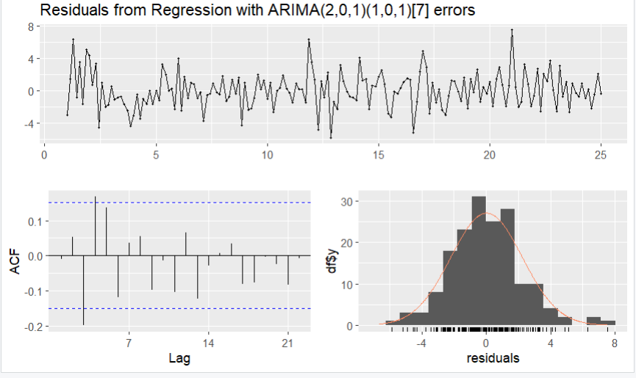
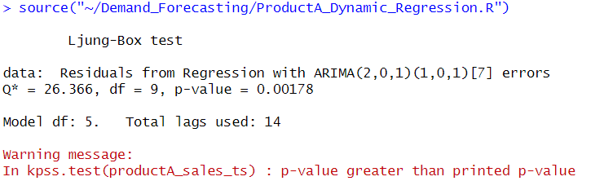
OUTPUT:ProductA_Dynamic_Regression.R :

Slide 13
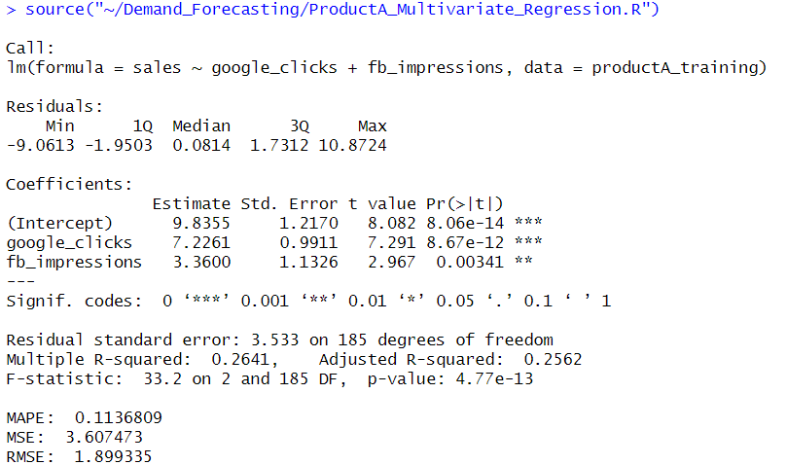
OUTPUT:ProductA_Multivariate_Regression.R

Slide 14
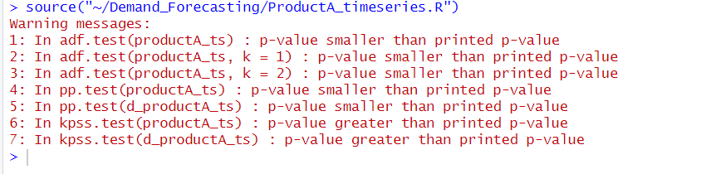
OUTPUT:ProductA_timeseries.R :

Slide 16
REFERENCES
[1] Vasiliki, K.; Vasileios, A.; Thomas, L.; George, F.; Elisavet, G.; Panagiotis, S. IDS for Industrial Applications: A Federated Learning Approach with Active Personalization. Sensors 2021, 21, 6743.
[2] Venkataramanan, K.; Kaza, S.; Annaswamy, A.M. DER Forecast using Privacy Preserving Federated Learning. arXiv 2021, arXiv:2107.03248.
[3] Susan Li (Jul 9, 2018) An End-to-End Project on Time Series Analysis and Forecasting with Python. https://towardsdatascience.com/an-end-to-end-project-on-time-seriesanalysis-and-forecasting-with-python-4835e6bf050b
[4] Mupparaju, Kalyan, Anurag Soni, Prasad Gujela, and Matthew A. Lanham. "A Comparative Study of Machine Learning Frameworks for Demand Forecasting." (2018).
[5]Demand Forecasting of E-Commerce Enterprises Based on Horizontal Federated Learning from the Perspective of Sustainable Development Juntao Li 1 , Tianxu Cui 1,* , Kaiwen Yang 1 , Ruiping Yuan 1 , Liyan He 1 and Mengtao Li 2

Slide 17
Thank you

